Slide 1
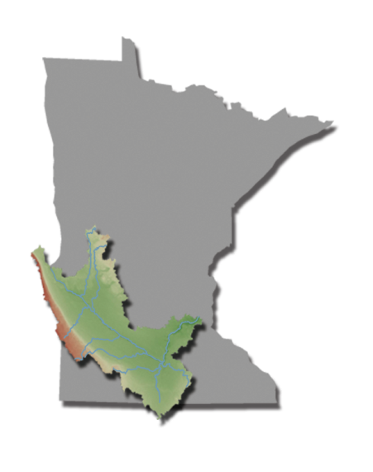

Slide 2
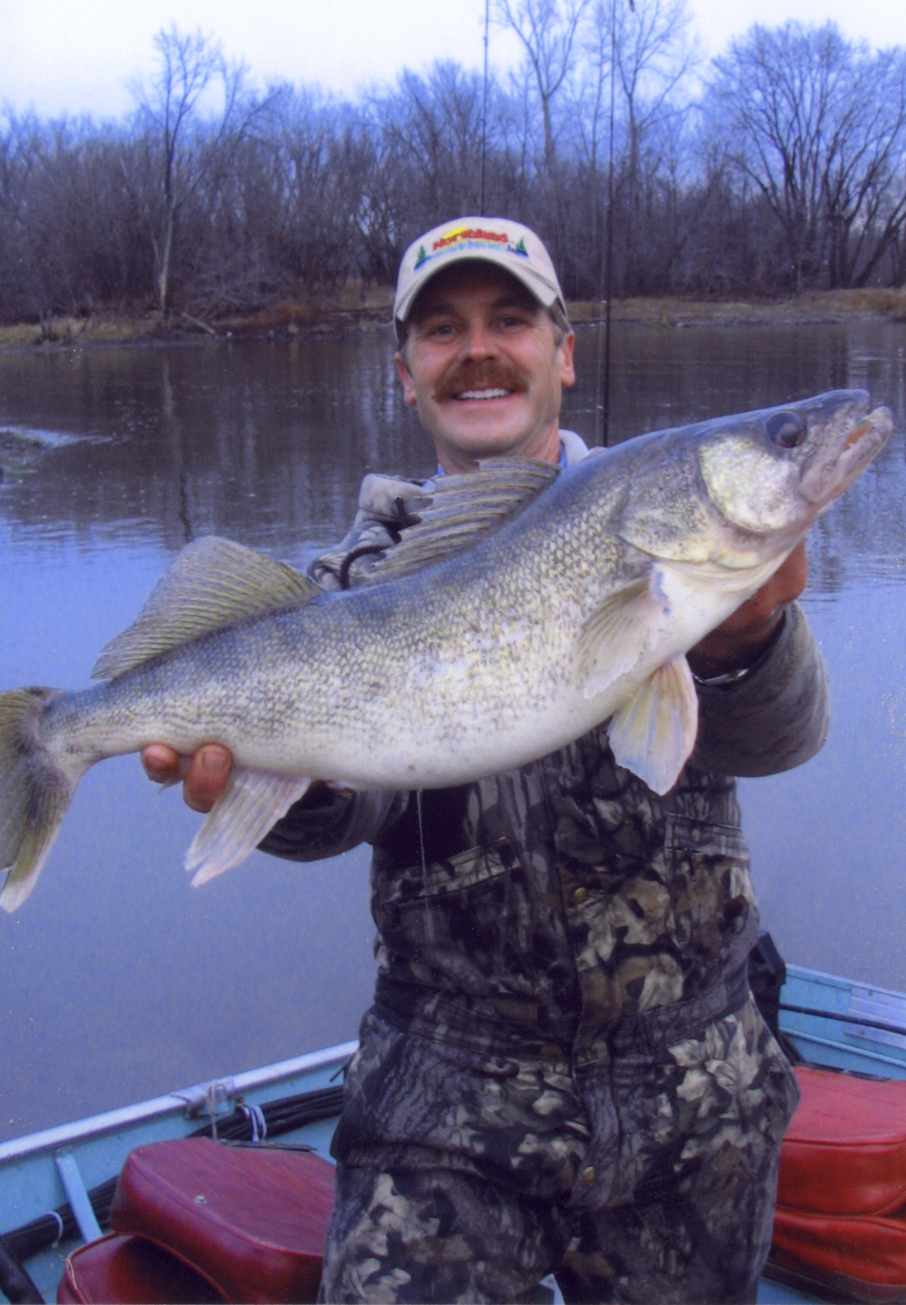
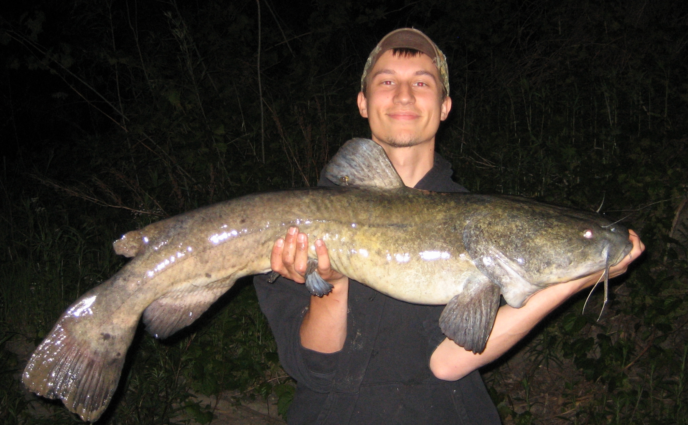
Fish
Flathead Catfish caught on MN river
16 lbs Walleye- caught on MN river

Slide 3
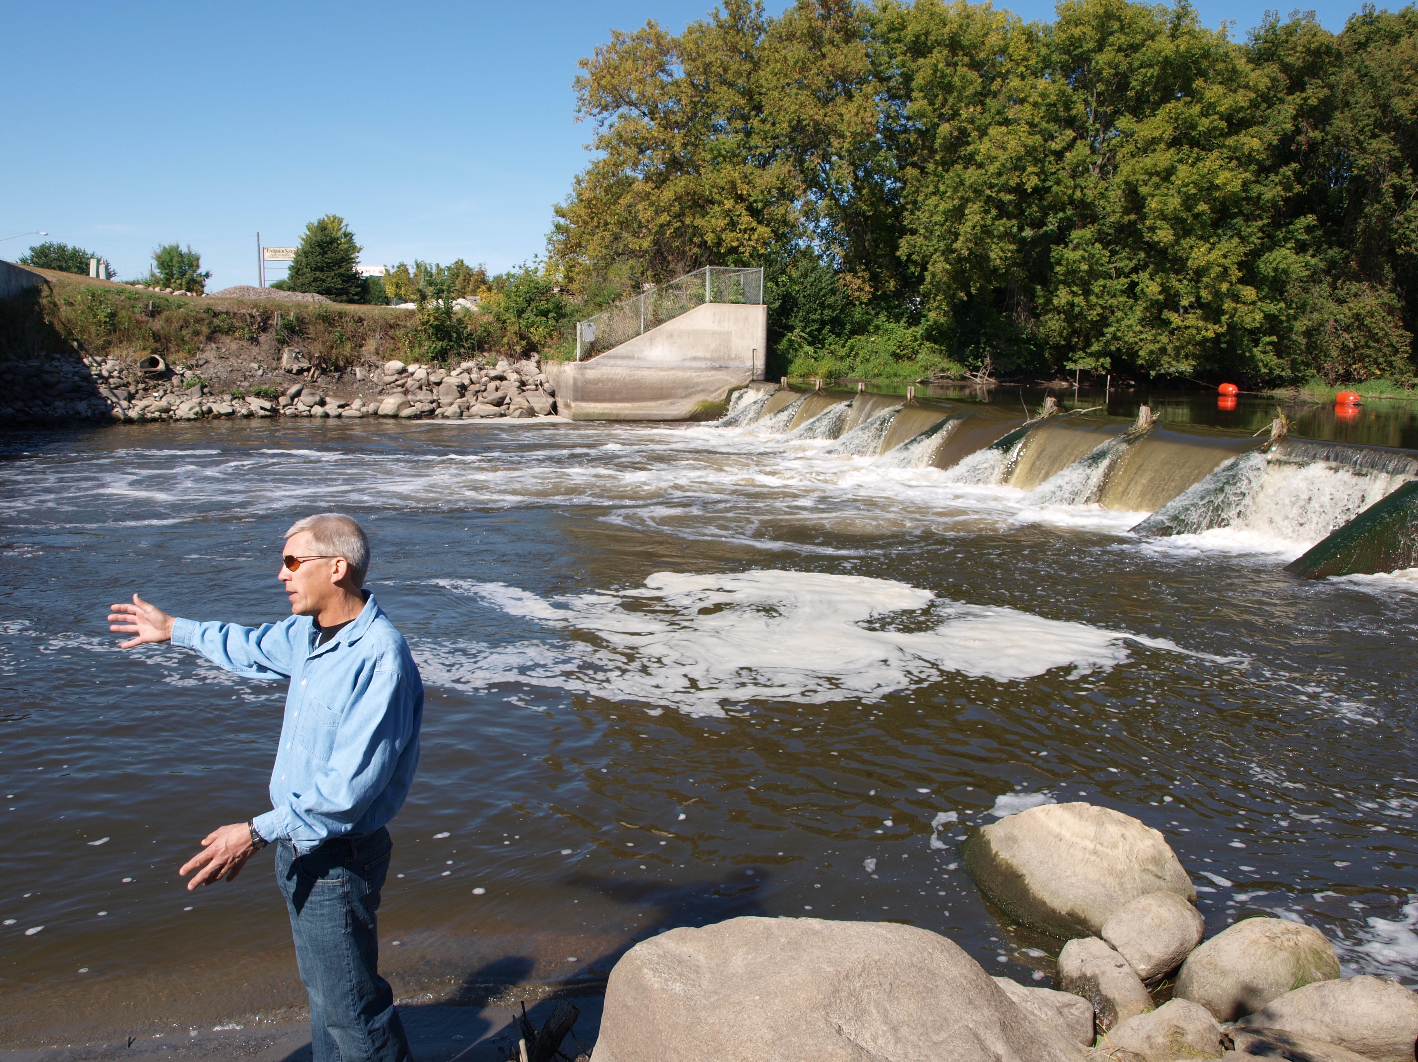
How do dams impact the health of the fisheries?
“One thing we know is our species diversity and the number of species goes up above a dam once we take it out.” - Chris Domeier, MN DNR Fisheries Biologist
Notes:
“Fish in this part of the country on the prairies evolved in flat flowing streams and not to jump five or six feet to get over a barrier like a dam. Fish migrate in the spring and fall of the year to complete important parts of their lifecycle and dams prevent them from doing that. One thing we know is our species diversity the number of species goes up above a dam once we take it out.” - Chris Domeier, MN DNR Fisheries Biologist

Slide 4
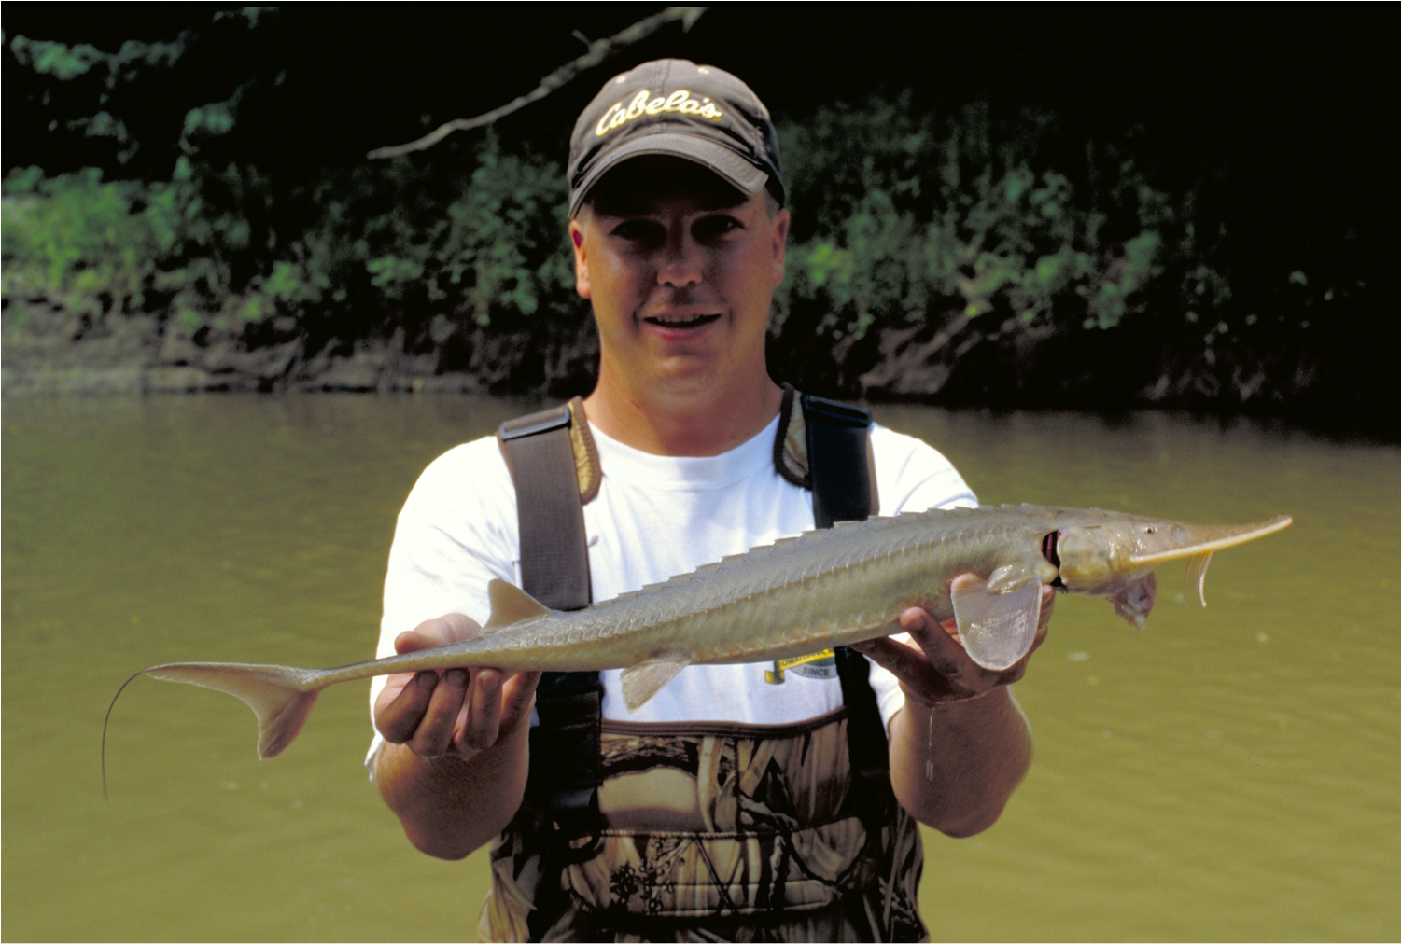
What is one unique characteristic about the Minnesota River fishery?
“You can’t look at the Minnesota River and not talk about its diversity. A total of just about a hundred species were found during a river-wide sampling…The one I am always amazed at is the shovelnose sturgeon.” - Brad Koenan, MN DNR Fisheries Technician
Notes:
“You can’t look at the Minnesota River and not talk about its diversity. A total of just about a hundred species were found during a river-wide sampling effort in the 1990s with a lot of those found in the tributaries. Typically, we see between 50 and 60 species during our electro fishing surveys on the main stem. I think people genuinely excited about some of the unusual species. The one I am always amazed at is the shovelnose sturgeon.” - Brad Koenan, MN DNR Fisheries Technician

Slide 5
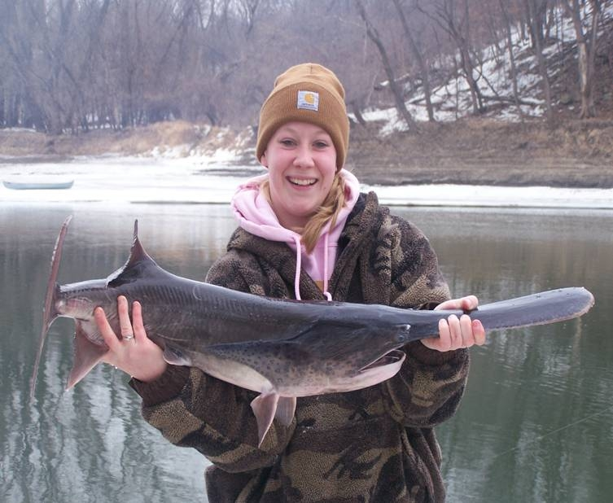
Has the fishery improved in the Minnesota River?
“We are seeing in our lifetime you know a resurgence of the Minnesota River.” - Dirk Peterson, MN DNR Fisheries Chief
Jen True
Paddlefish
Caught on
MN River
Notes:
“We have come a long way with the Minnesota River you know as recently as the 50s a professor at the University that wrote a book about the distribution of Minnesota fishes did seine hauls out there and really found peas and carrots and stuff from canning factories as well as human waste from unsewered communities in his seine hauls. Not surprisingly very few fish and since then recent surveys have shown seventy different species of fish are now found in the Minnesota River. Some of them are really sensitive to water quality and other habitat parameters and are even surprising to us that they are reentering the river like paddle fish, black buffalo and some of these other species that are really quite sensitive to habitat conditions. We are seeing in our lifetime you know a resurgence of the Minnesota River.” - Dirk Peterson, MN DNR Fisheries Chief

Slide 6
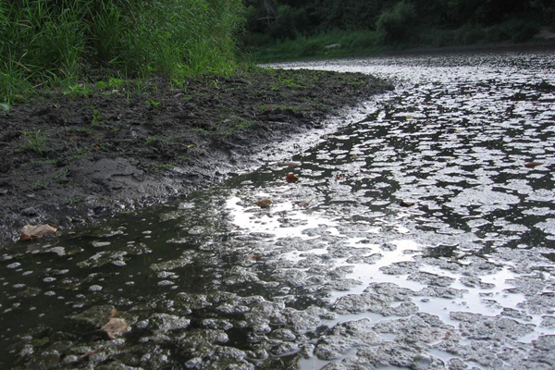
What are some of the reasons behind this resurgence of the Minnesota River fishery?
“It is the result of many factors whether it would be good sewage treatment plants that our communities are reducing phosphorus and other waste materials.” - Dirk Peterson, MN DNR Fisheries Chief
Notes:
“It is the result of many factors whether it would be good sewage treatment plants that our communities are reducing phosphorus and other waste materials. It also good targeting of government programs like Minnesota CREP easements throughout the watershed to the tune of 100,000 acres, protecting riparian lands, permanent vegetation all of those things contributing to limiting the movement of sediment and nutrients to the river that are ultimately harmful to the health and wellbeing of the fish community.” - Dirk Peterson, MN DNR Fisheries Chief

Slide 7
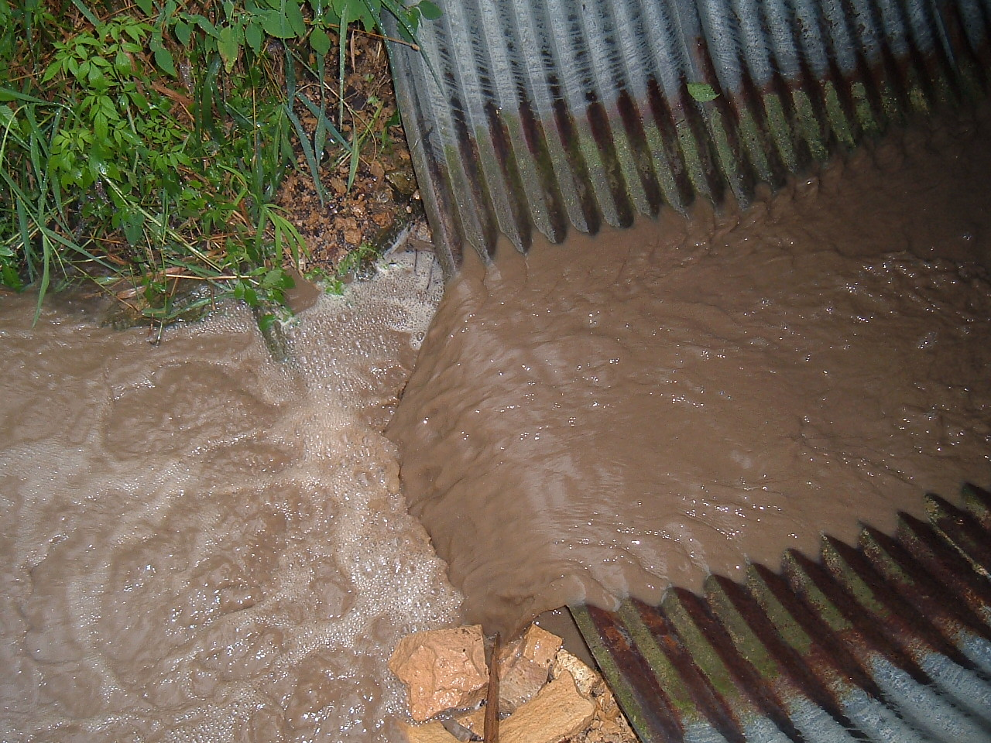
What is the biggest water quality issue for the Minnesota River fishery?
“Our biggest issue when it comes to fisheries in the Minnesota River is the amount of sediment that is moving down the river and its effect on everything…” - Chris Domeier, MN DNR Fisheries Biologist
Notes:
“Our biggest issue when it comes to fisheries in the Minnesota River is the amount of sediment that is moving down the river and its effect on everything from mussel species that need somewhat clean water to live and filter food out to fish spawning and fish food itself. It changes the whole makeup of the whole food chain of the river when you have a lot of silt. A cleaner river you see a cleaner food system, you see better species, more desirable species.” - Chris Domeier, MN DNR Fisheries Biologist

Slide 8
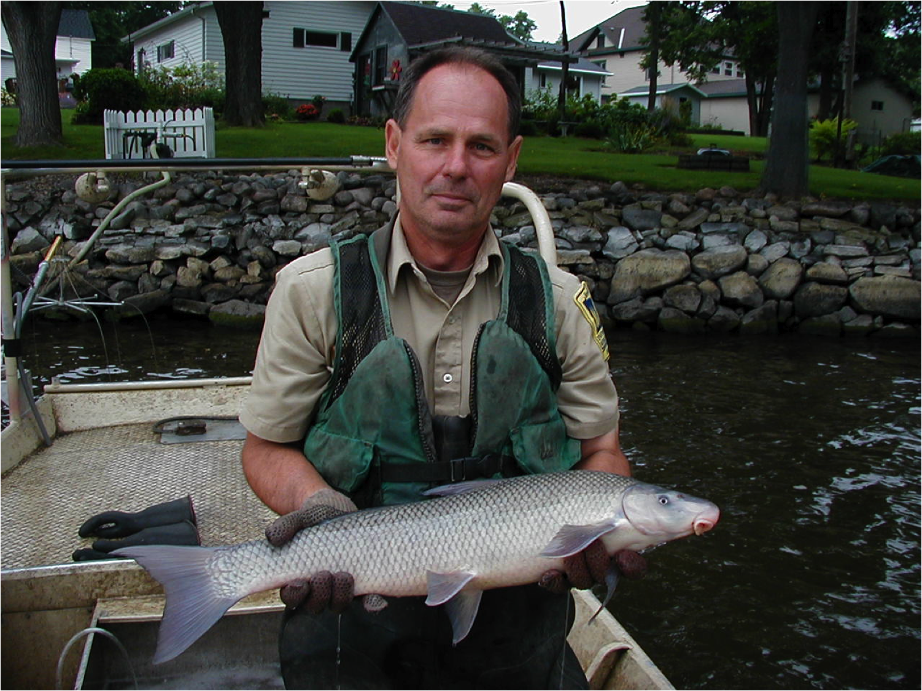
What are some of the pollution sensitive species that might provide an insight for improving water quality?
“…good indicators of water quality is the blue sucker for sure. They are a real unique species. We are seeing more paddle fish. Lake Sturgeon are a great indicator. We are seeing more Lake Sturgeon…” - Chris Domeier, MN DNR Fisheries Biologist
Notes:
“Some of the more unique species that we’re finding in the river and we like to see and are good indicators of water quality is the blue sucker for sure. They are a real unique species. We are seeing more paddle fish. Lake Sturgeon are a great indicator. We are seeing more Lake Sturgeon showing up more often in the catches by anglers. This isn’t the river that was when I was 10 years old when we took our poles down in New Ulm to fish.” - Chris Domeier, MN DNR Fisheries Biologist

Slide 9
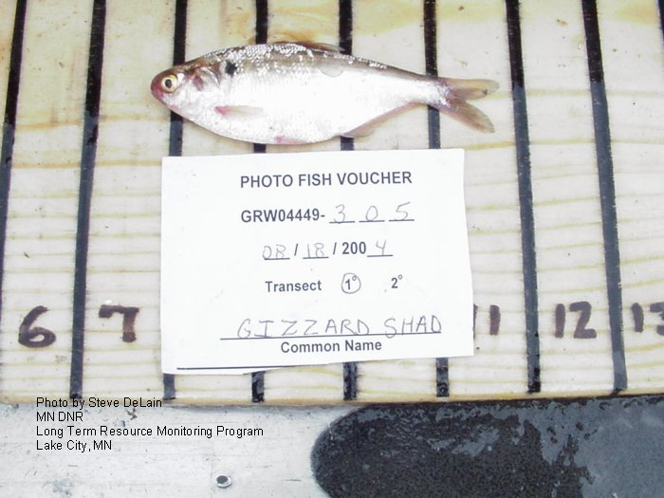
What type of information are you collecting during a fish survey?
“We are basically measuring all the fish. All the fish are measured. The smaller fish are counted and weighed. The weight portion of this especially on individual fish gives us what we call K-factors or condition factors on fish” - Brad Koenan, MN DNR Fisheries Technician
Notes:
“We are basically measuring all the fish. All the fish are measured. The smaller fish are counted and weighed. The weight portion of this especially on individual fish gives us what we call K-factors or condition factors on fish. Basically it speaks up the relative health of the fish. If you have walleyes that are very, very fat, very heavy for their length obviously we have excellent growing conditions and if we have fish that are emancipated or very skinny than we are looking at fish that obviously are struggling. It is important to us to get those weights on individual fish to make those decisions on the health of the system as a whole.” - Brad Koenan, MN DNR Fisheries Technician

Slide 10
“Ask-an-Expert about the Minnesota River” profiles
scientists and citizens answering questions about
the health of the Minnesota River.
Produced by the Water Resources Center at Minnesota State
University, Mankato
To learn more, visit the Minnesota River Basin Data:
mrbdc.mnsu.edu/learn

