Slide 1
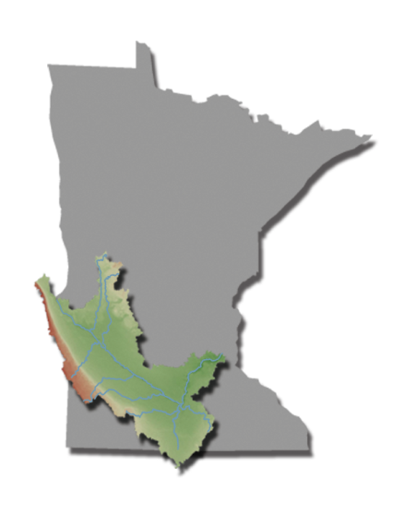
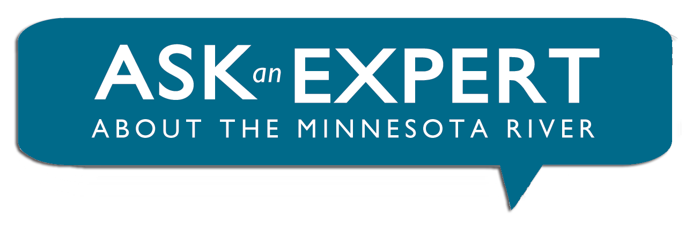

Slide 2

Wetlands in the Minnesota river basin

Slide 3
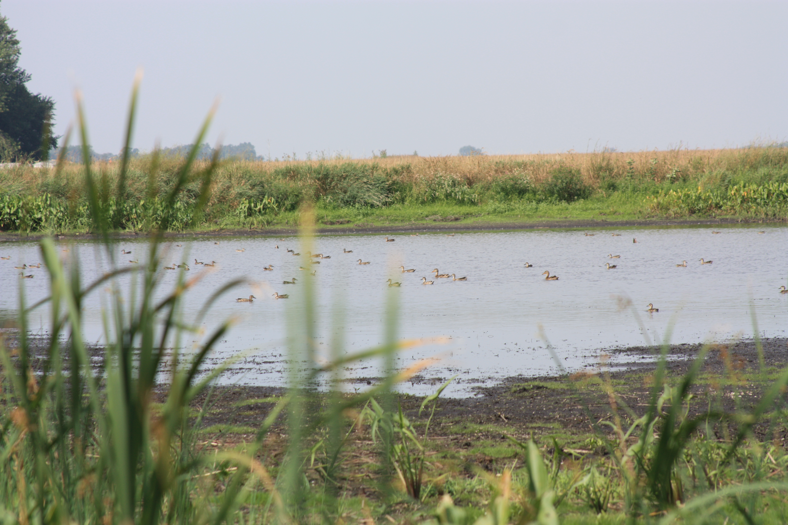
Types of Wetlands
Seasonal Basins or flats are small, isolated wetlands that contain water only seasonally. Seasonal basins or flats are found throughout Minnesota including Fort Snelling State Park.
Shrub and Wooded swamps are shrubby or forested wetlands found along the edges of lakes, rivers, and streams

Slide 4
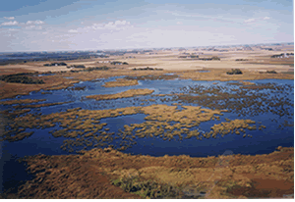
Types of Wetlands
Prairie potholes are shallow depressions formed by retreating glaciers. They provide excellent habitat and breeding grounds for migratory birds. Sibley, Crow Wing, and Maplewood State Parks provide good examples of these wetlands.

Slide 5
Benefits of Wetlands
Erosion control. Wetland vegetation reduces erosion along lakes and stream banks by reducing forces associated with wave action.

Slide 6
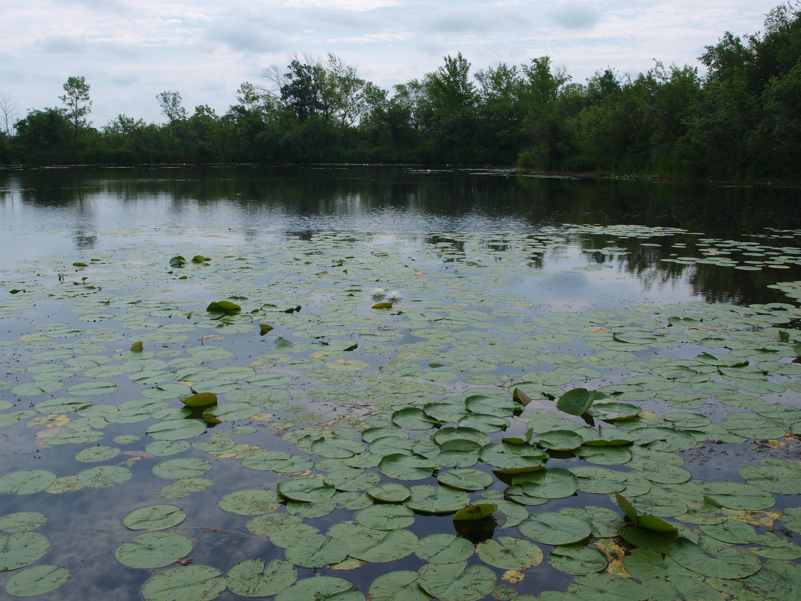
Benefits of Wetlands
Flood control. Wetlands can slow runoff water, minimizing the frequency streams and rivers reach catastrophic flood levels.
MPCA
Ground water recharge and discharge. They receive ground water even during dry periods. This helps reduce the impact of short-term droughts on rivers and streams.

Slide 7
Benefits of Wetlands
Natural filter. Allowing cleaner water to flow into the body of water beyond or below the wetland.

Slide 8
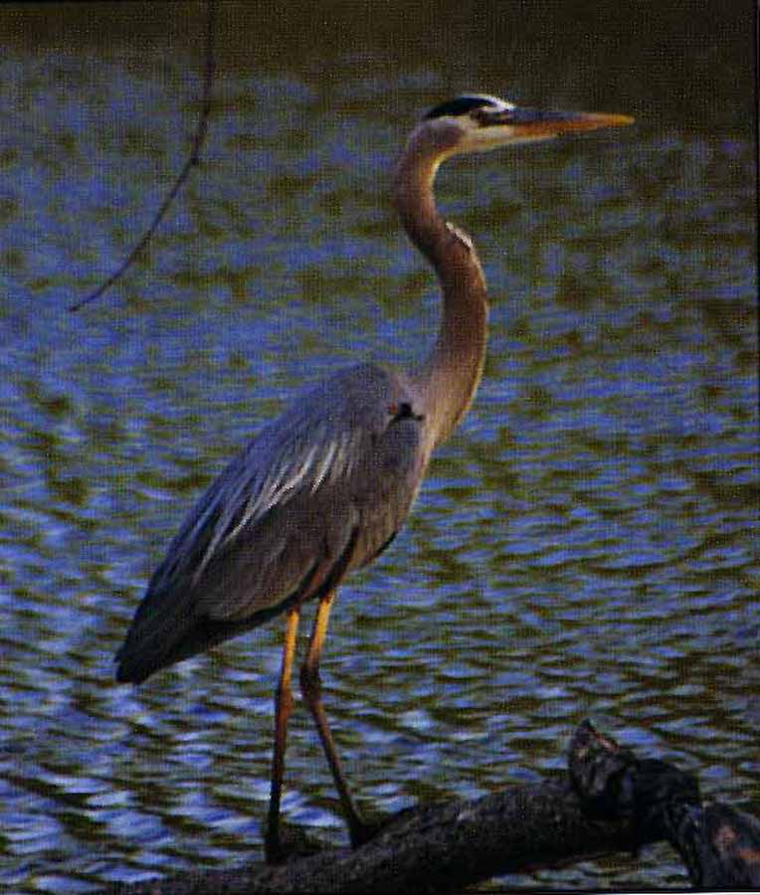
Wildlife Habitat
Fisheries habitat. Many species of fish utilize wetland habitats for spawning, food sources, or protection.
Rare species habitat. 43 per cent of threatened or endangered species in the U.S. live in or depend on wetlands. This includes plants and animals.
Wildlife habitat. Many animals depend on wetlands for homes and resting spots. Fish, amphibians, reptiles, aquatic insects and certain mammals need wetlands as a place for their young to be born and grow.

Slide 9
Struggling to stay alive
River Otters timeline
Pre-settlement | Are Present, used most waterways including the Minnesota River
Early 1900’s | The River Otters range is greatly reduced because of wetland drainage and destruction of habitat
Early1980’s | 21 otters are released in the upper Minnesota River basin in west-central Minnesota
Today | There are an estimated 11,000 otters in the state (mostly in the northern half, but with increasing numbers and distribution in the south).
River Otters
Mortality Factors
Drainage of wetlands
Regulated trapping
Pollutants
Loss of Habitat
Vehicle collisions

Slide 10
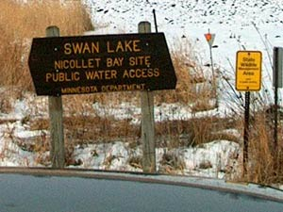
The “Duck Factory”
Minnesota River Basin is in the so-called
“duck factory”
North America’s best waterfowl breeding habitat.
Ducks rely on upland areas around wetlands and shallow lakes for both nesting and as a food source.
Time | Outlook for Swan Lake & Duck Production
1947 | 27,000 acres and 18,000 ducks
1984 | 16,500 acres and less than 100 ducks
1986 | MN DNR initiated a ten-year Swan Lake Area Wildlife Project to increase upland habitat and develop an effective water management plan
Today | Lake annually produces between 6,000- 8,000 ducks. But the unexpected release of carp into the lake, can drastically reduce a duck’s food source.

Slide 11
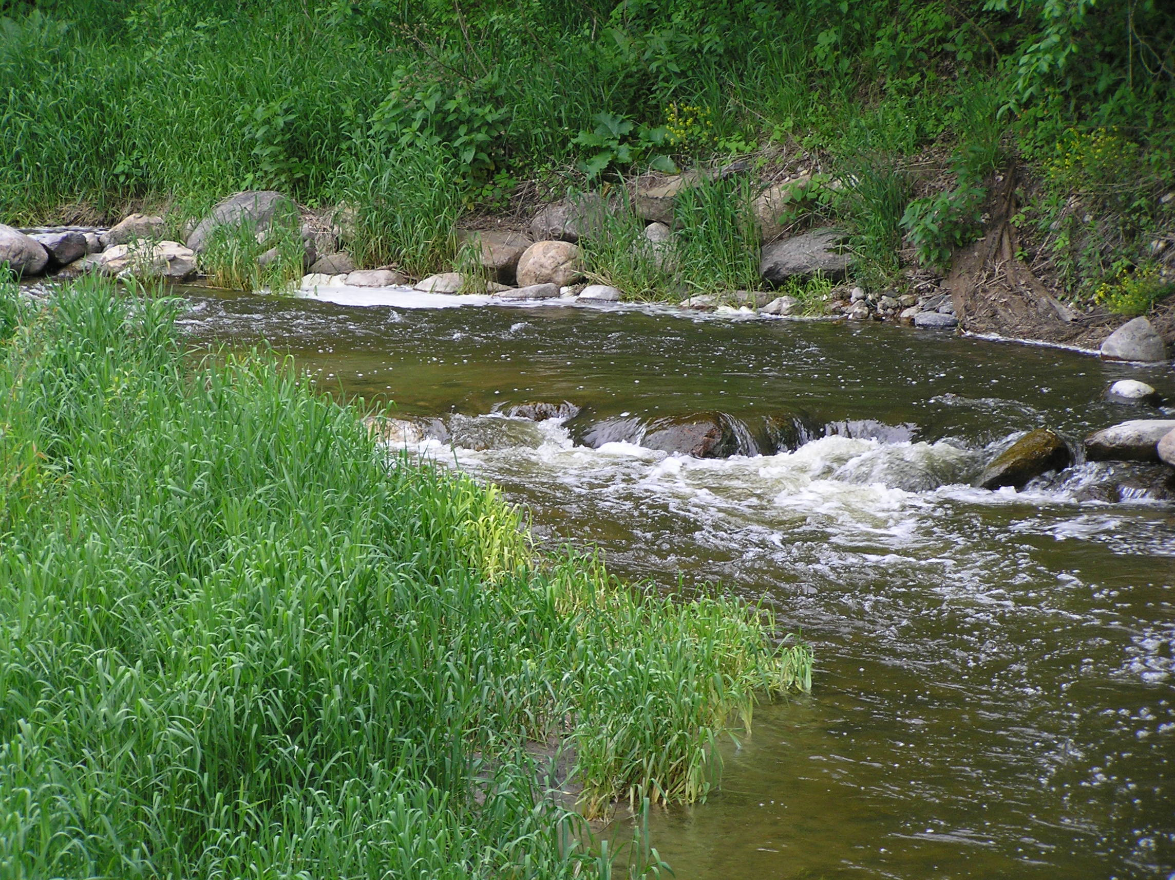
Seven Mile Creek
Seven Mile Creek Virtual Tour

Slide 12
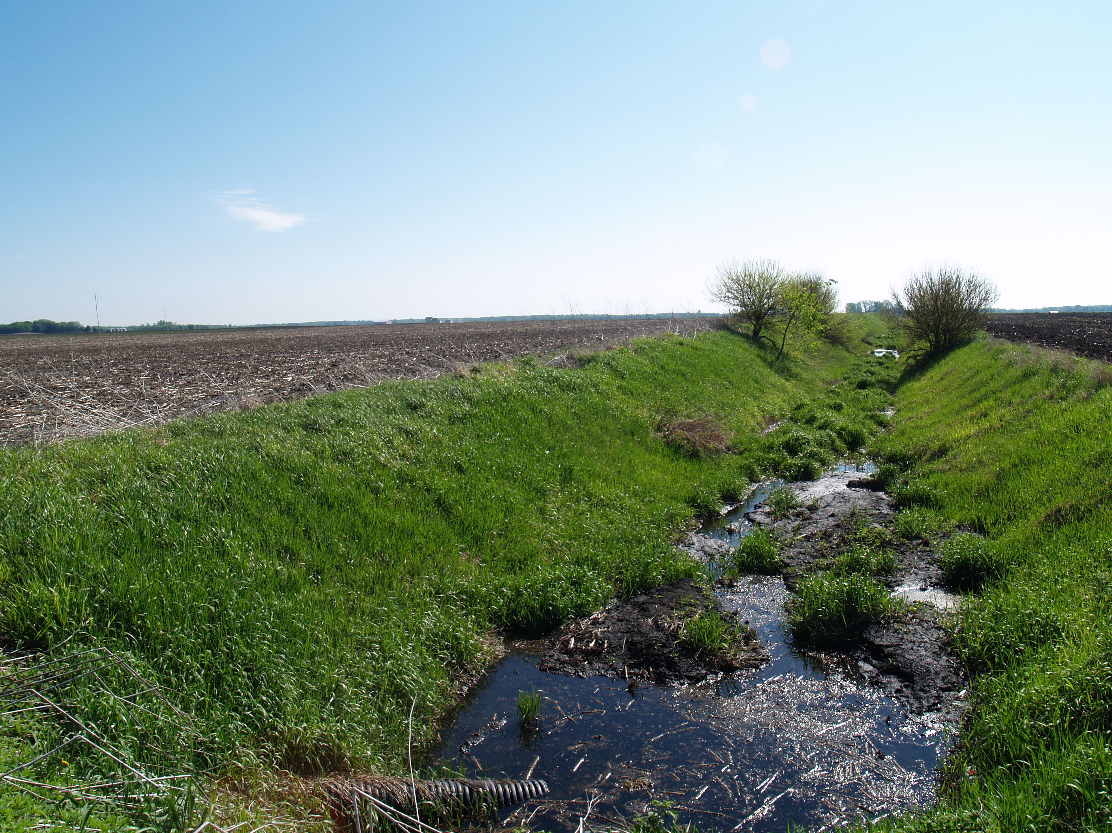
Land Drainage
The landscape has been drastically altered since settlers moved in and drained the wetlands to farm the rich, productive farmland.
As a result of expanding drainage tile lines and ditches, large, previously isolated wetlands were artificially connected to the Minnesota River.
The Department of Natural Resources estimates that over 90% of the wetlands in the prairie have been lost.
Video 1
Video 2

Slide 13
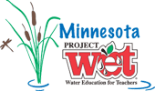
What’s being done now?
From the Minnesota Supreme Court's 1976 decision disallowing the construction of a highway through William Bryson's marsh, which he brought suit to save.
"To some of our citizens a swamp or marshland is physically unattractive, an inconvenience to cross by foot and an obstacle to road construction or improvement.
"It is quiet and peaceful - the most ancient of cathedrals - antedating the oldest of manmade structures. More than that, it acts as nature's sponge, holding heavy moisture to prevent flooding during heavy rainfalls and slowly releasing the moisture and maintaining the water tables during dry cycles.
"In short, marshes and swamps are something to preserve and protect.”

Slide 14
Sources
Minnesota DNR. 2011.
http://www.dnr.state.mn.us/wetlands/index.html
Minnesota River Basin Data Center. Oct 2004.
http://mrbdc.mnsu.edu/sites/mrbdc.mnsu.edu/files/public/major/midminn/subshed/sevenmi/vtour/smvt_1.html

Slide 15
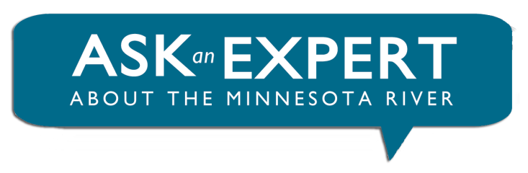


“Ask-an-Expert about the Minnesota River” profiles
scientists and citizens answering questions about
the health of the Minnesota River.
Produced by the Water Resources Center at Minnesota State University, Mankato
To learn more, visit the Minnesota River Basin Data:
mrbdc.mnsu.edu/learn

