Slide 1
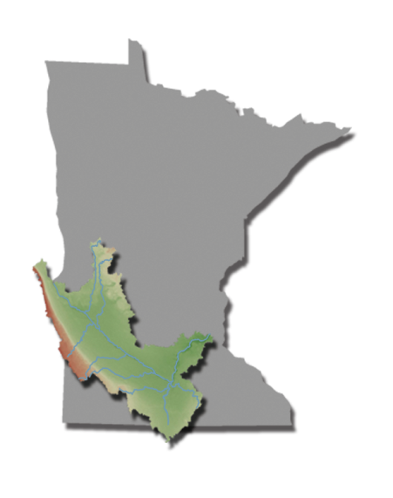

Slide 2
MUSSELS The Canaries of Water Quality
“Mussels are among the most endangered group of animals in the world. Freshwater mollusks are imperiled worldwide. Several of them are extinct and we can’t find them.” – Bernard Sietman
Notes:
Mussels are among the most endangered group of animals in the world and much of it stems from the changes that have occurred to their habitat over the last 200 years. At least 70 percent of mussels in North America are extinct, imperiled or in need of special protection according to organizations like The Nature Conservancy. Compared to 16.5 percent of mammalian species and 14.6 percent of bird species. In the last 20 years scientists began to discover the loss of some mussel species and the need to step up the research process.

Slide 3
Why do we refer to mussels as the Canary in the Coalmine?
“If the mussels aren’t living in the river anymore it is like the canary dying in the coalmine. It’s time to do something different.” – Mike Davis

Slide 4
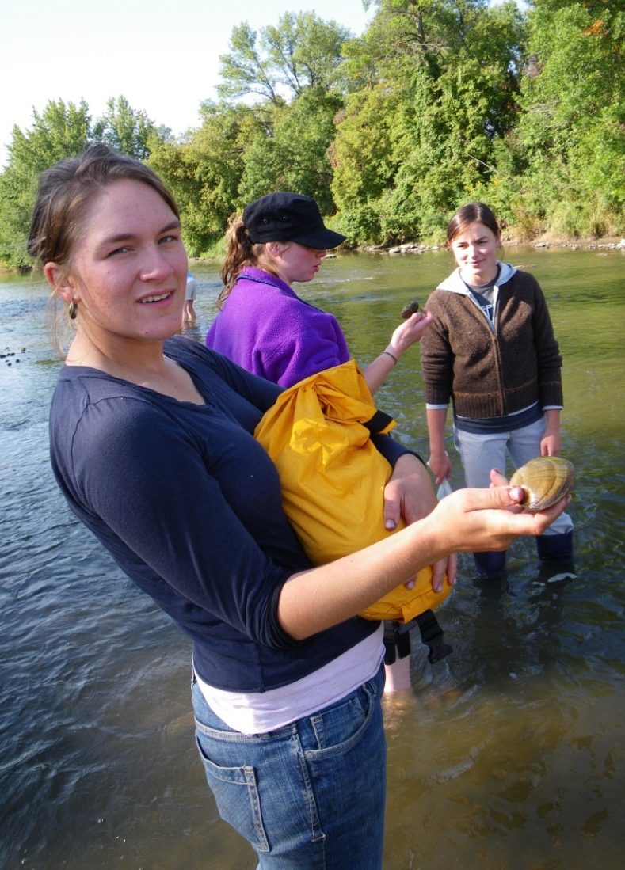
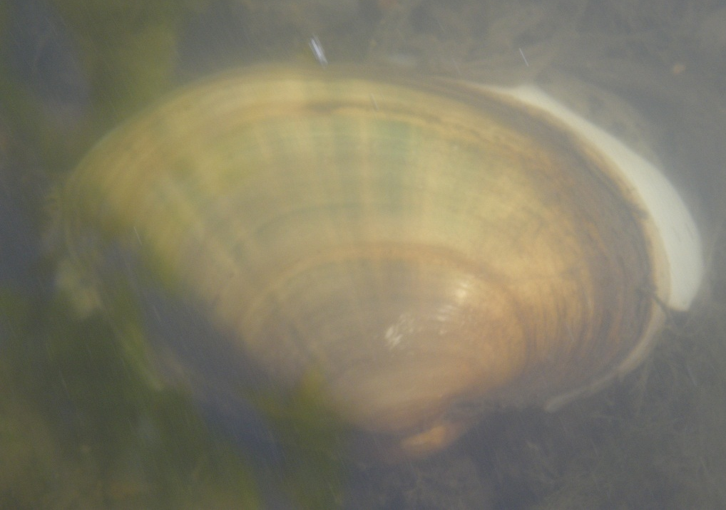
What is a Mussel?
A freshwater organism that can be found in rivers and lakes on every continent except Antarctica.

Slide 5
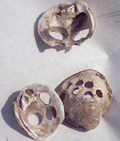
A historical perspective of mussels
Mussels have been used for thousands of year by people as a food source, tools and jewelry.

Slide 6
Why do we study mussels?
“They are like benthic macroinvertebrates and act as sentinels for water quality. They tell us a lot about the habitat, ecosystem and water quality in the river systems.” – Paul Wymar

Slide 7
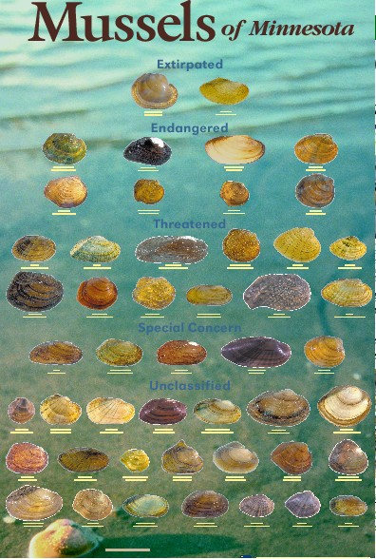
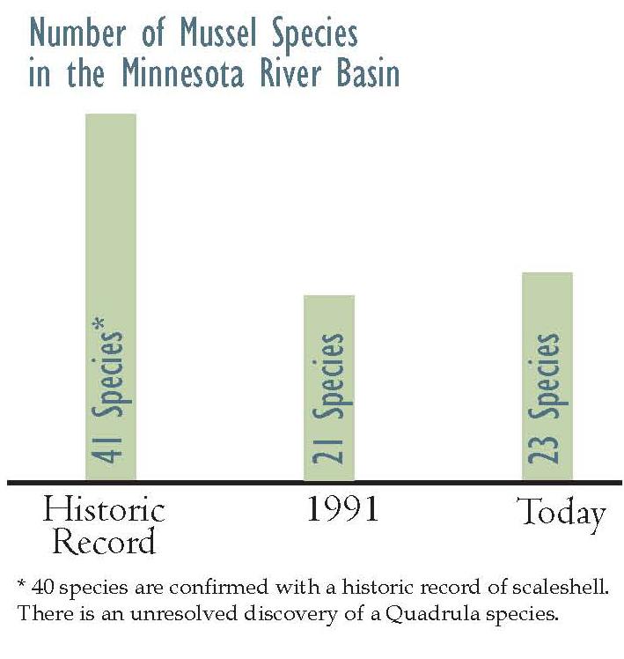
Historically, what was the mussel assemblage like in the MN River Basin?
“The Minnesota River Basin historically had an outstanding mussel assemblage. It supported 41 species of mussels.” – Bernard Sietman

Slide 8
What is the current status of mussels in the MN River Basin?
“Generally we lost about 50% of what used to be here. In the lower Minnesota, we’ve lost 2/3rds of species that once lived there.” – Mike Davis

Slide 9
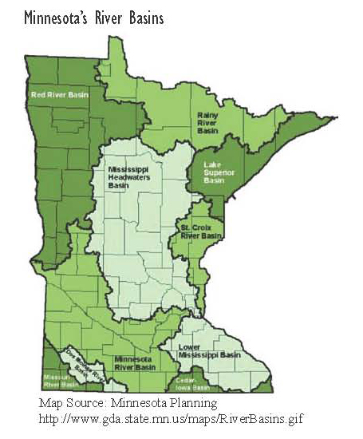
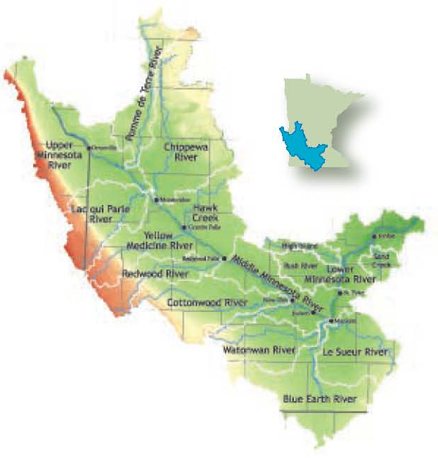
How does the Minnesota River compare to other major basins in the state?
“In the lowest categories of river unfortunately. I think the Minnesota is at the bottom of the list statewide.” – Mike Davis

Slide 10
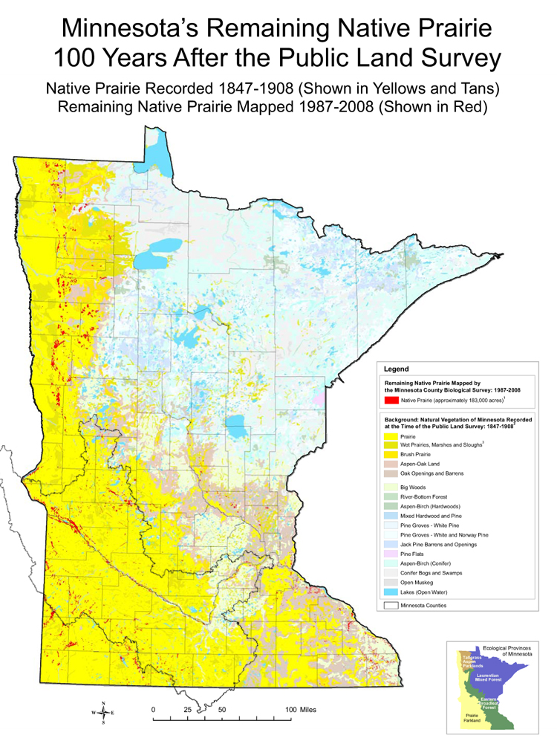
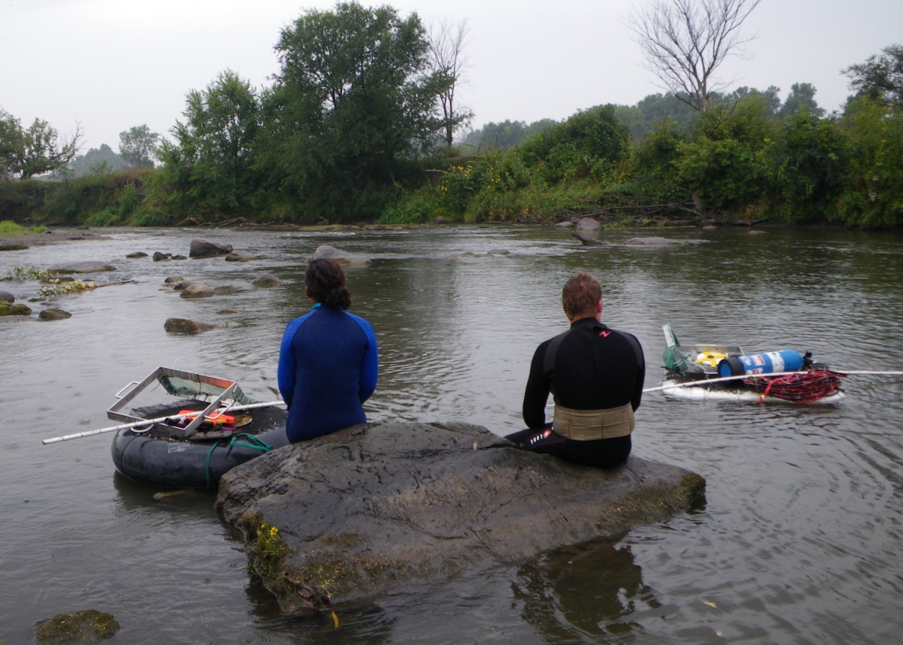
Why have mussels declined in the Minnesota River Basin?
A variety of factors revolving around a dramatic transformation of a prairie – wetland landscape.

Slide 11
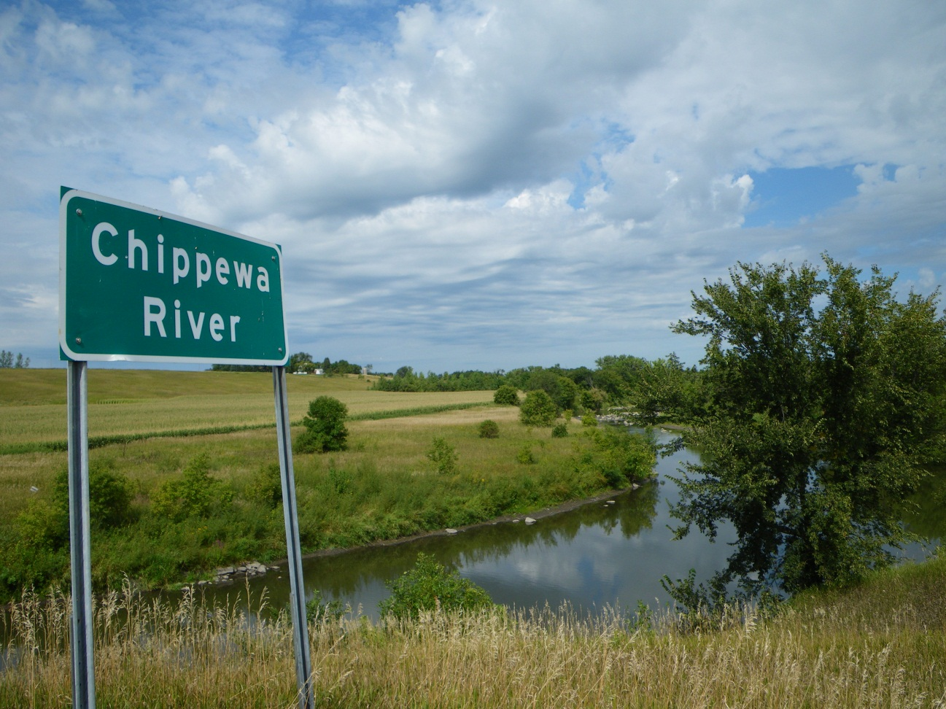
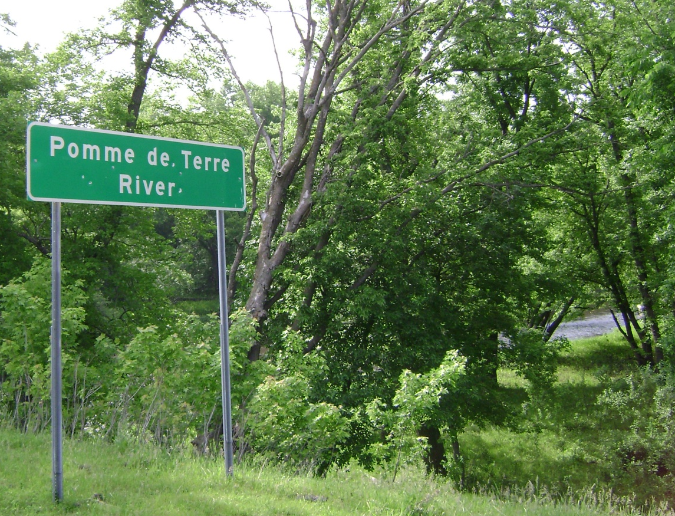
Where are mussels doing ok in the MN River Basin?
The Chippewa and Pomme de Terre rivers in the upper headwaters of the Minnesota River Basin.

Slide 12
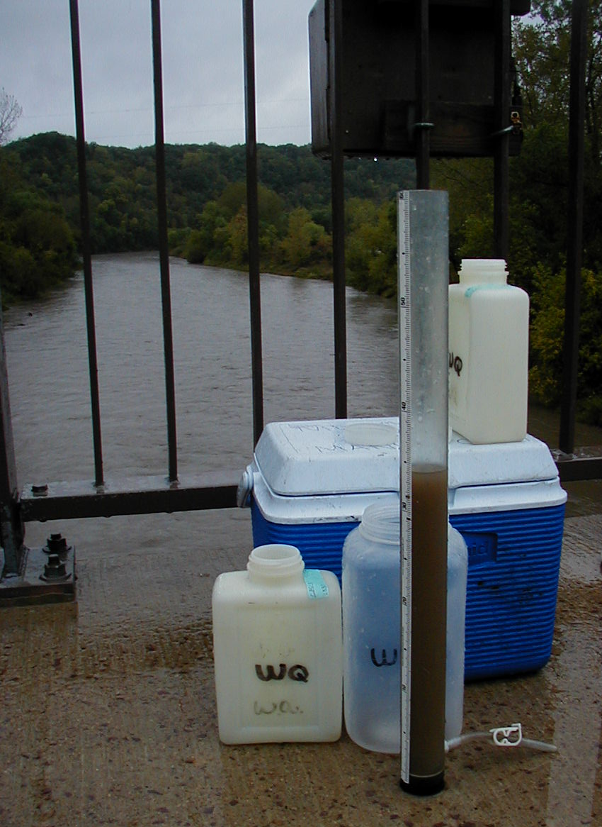
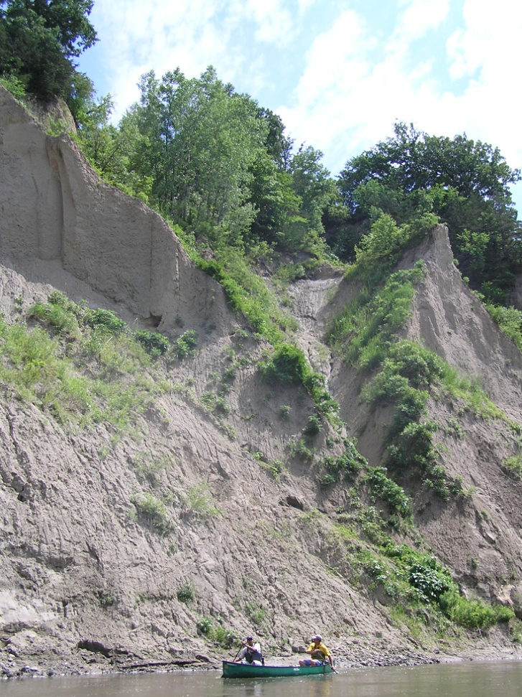
What is one watershed where mussels have declined?
The Greater Blue Earth River Watershed (including the Watonwan and Le Sueur rivers).

Slide 13
What is the typical lifecycle of a mussel?
Mussels have one of the fascinating lifecycles in the animal world that involves using fish as a host for their larvae.

Slide 14
What is an example of mussels using fish as hosts
“Those mussels who are still fairly common in the Minnesota River and several of them use the freshwater drum or sheepshead as a host fish.” – Mike Davis

Slide 15
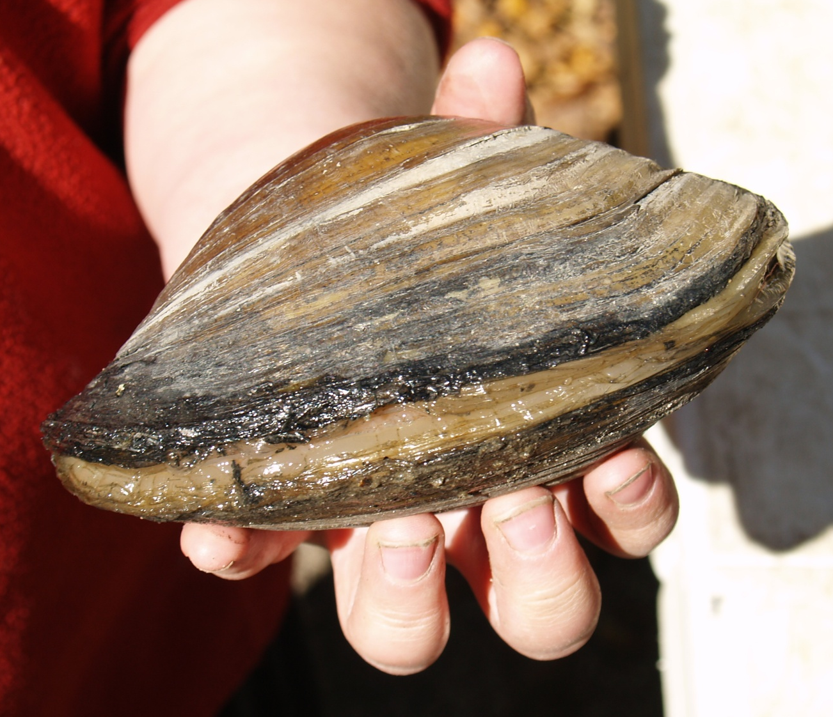
How long do mussels live?
“Depending on the species they can be very long-lived. Some of them could live to be over 100 years old.” – Mike Davis

Slide 16
How do mussels move?
“Very slowly, very deliberately. They have a little thing that we call it a foot because they used it for locomotion.” – Mike Davis

Slide 17
How far can a mussel move and why?
Mussels usually don't move much, but a muscular "foot" helps them burrow and allows limited travel if disturbed by floods or drought.

Slide 18
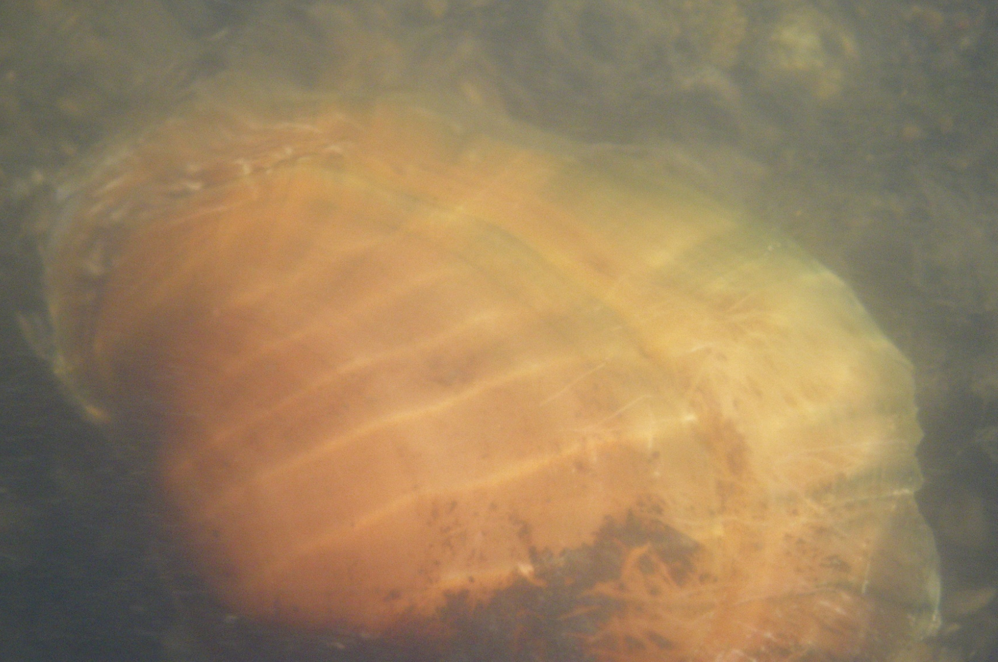
What do mussels eat?
“A lot of what they are eating is the bacteria and fungus that is decomposing organic matter.” – Mike Davis

Slide 19
What eats a mussel?
VIDEO
Fish are a main predator when the mussel is small and later its mammals like the muskrat and raccoon.

Slide 20
Why do we care about mussels?
If we lose our freshwater mussels, we lose more than a biological legacy unmatched in the world. We lose a part of our cultural heritage, we lose an economic resource, and we lose an environmental health maintenance and warning system.

Slide 21
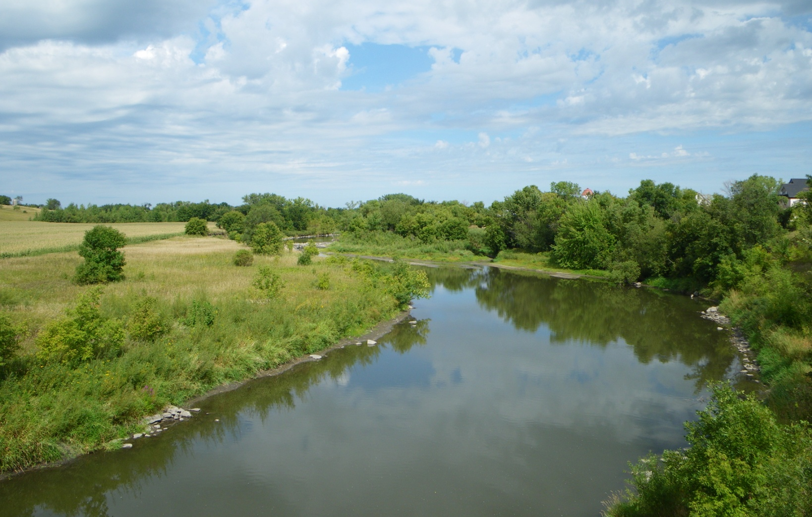
What are idea conditions for a healthy mussel assemblage?
“A stable river environment. Stable by that I mean not a lot of erosion and deposition.” – Mike Davis

Slide 22
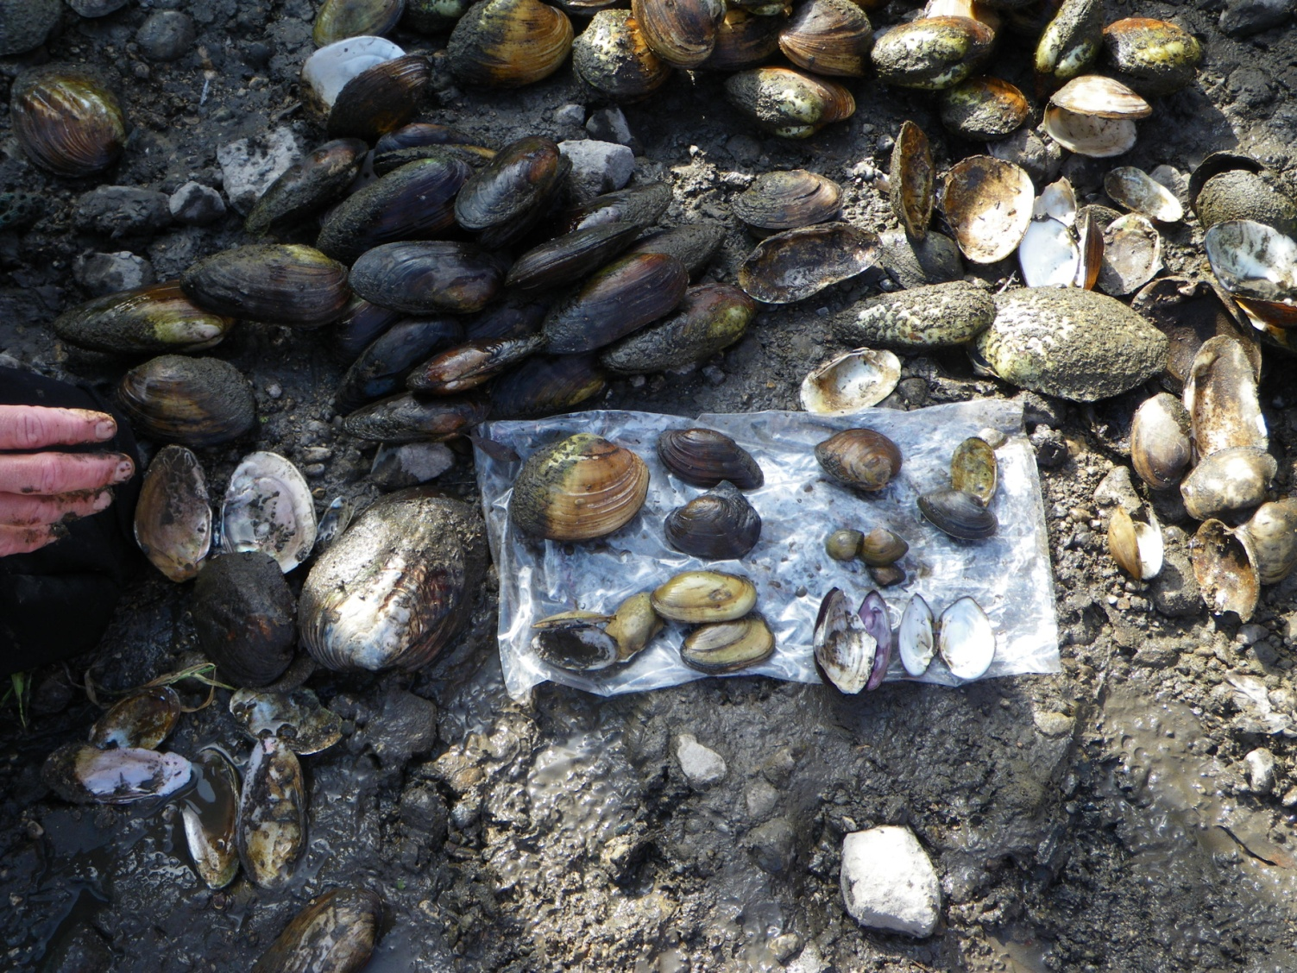
How do mussels impact water quality?
A mussel’s filtering ability makes them natural water purifiers and they respond to changes in water quality.

Slide 23
What is another important ecosystem benefit of mussels?
When there is a healthy mussel population, they will form a dense bed on the riverbed it creates a unique ecosystem.

Slide 24
What does the future hold for Mussels in the MN River Basin?
“Some things are improving, some fish are moving back, some important fish species. The mussels haven’t returned and it is probably a habitat issue.” – Bernard Sietman

Slide 25
“Ask-an-Expert about the Minnesota River” profiles
scientists and citizens answering questions about
the health of the Minnesota River.
Produced by the Water Resources Center at Minnesota State
University, Mankato
To learn more, visit the Minnesota River Basin Data:
mrbdc.mnsu.edu/learn
Thank you:
Bernard E. Sietman, Minnesota Department of Natural Resources
Mike Davis, Minnesota Department of Natural Resources
Paul Wymar, Chippewa River Watershed Project
Funding was provided by the Minnesota Environment and Natural Resources
Trust Fund as recommended by the Legislative-Citizen Commission on
Minnesota Resources (LCCMR) and the McKnight Foundation.

